Slide 1
Ames Home Sales Analysis
Focus: Find the factors that drive home prices for investment into mortgage-backed securities

Slide 2
Data Overview
Records for 1460 home sales
80 Columns describing each home
Homes sales from 2006-2010
Average Sale Price: $180,921

Slide 3
Analysis Method
Reviewed columns
Pared down data
Bucketed each column
Created pivot tables
Charted histograms
Conducted t-tests
Graphed results

Slide 4
Variables of Focus
Year Built
Above Grade Square Footage
Total Rooms
Fireplace
Garage Spaces

Slide 5
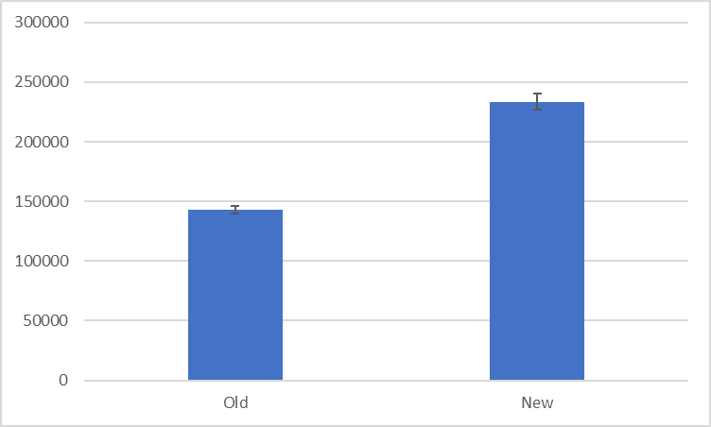
Year Built
Old (Pre-1980) vs. New (1980+)
Counts
Old – 848
New – 612
Average Sale Price
Old – $142,988
New – $233,482
There is a statistically significant difference in the average sale price of homes built before 1980 and homes built 1980 or later.

Slide 6
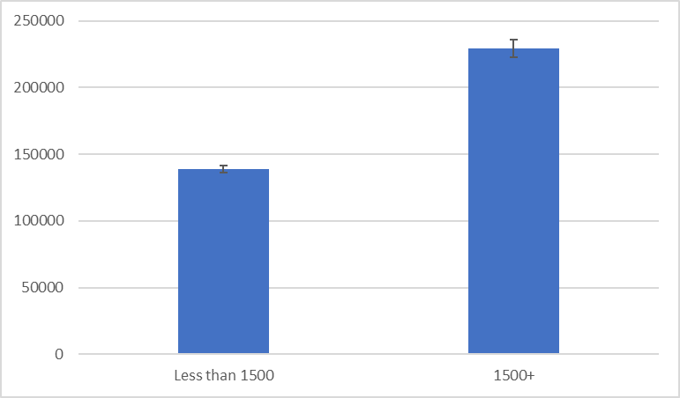
Above Grade Square Footage
Less than 1500 vs. 1500+
Counts
Less than 1500 – 782
1500+ – 678
Average Sale Price
Less than 1500 – $139,046
1500+ – $229,220
There is a statistically significant difference in the average sale price of homes with less than 1500 square feet and homes of 1500 square feet and above.

Slide 7
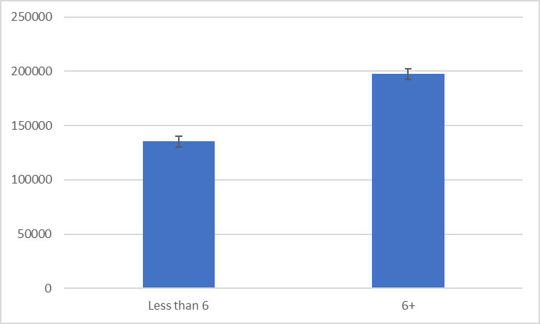
Total Rooms (Above Grade)
Less than 6 vs. 6+
Counts
Less than 6 – 390
6+ – 1070
Average Sale Price
Less than 6 – $135,314
6+ – $197,544
There is a statistically significant difference in the average sale price of homes with less than 6 rooms and homes with 6+ rooms.

Slide 8
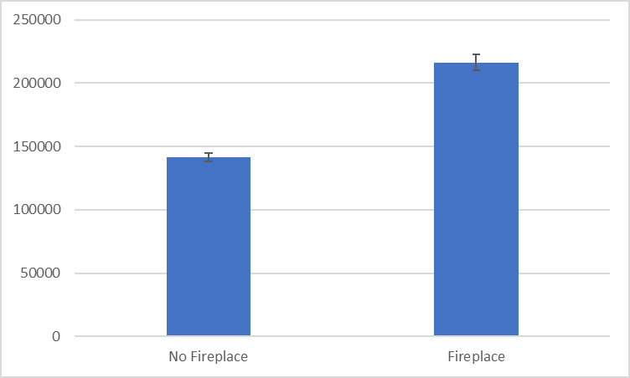
Fireplace
No fireplace vs. At least one fireplace
Counts
No fireplace – 690
At least one fireplace – 770
Average Sale Price
No fireplace – $141,331
At least one fireplace – $216,398
There is a statistically significant difference in the average sale price of homes without a fireplace and homes with at least one fireplace.

Slide 9
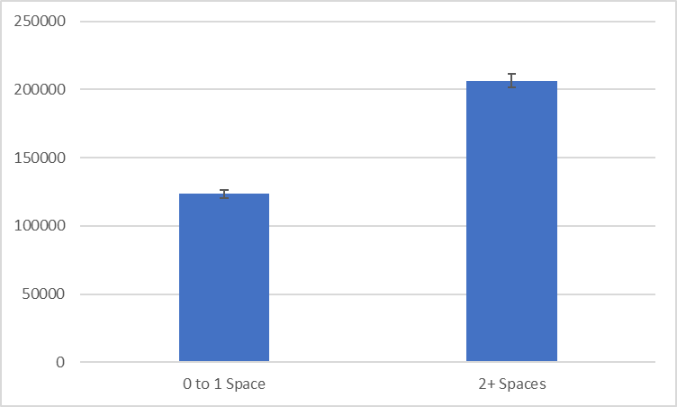
Number of Garage Car Spaces
0 or 1 vs. 2+
Counts
0 or 1 – 450
2+ – 1010
Average Sale Price
0 or 1 – $123,653
2+ – $206,437
There is a statistically significant difference in the average sale price of homes with 0 or 1 garage space and homes with 2+ garage spaces.

Slide 10
Recommendations
Focus on key characteristics of homes:
Year Built
Above Grade Square Footage
Total Rooms Above Grade
Fireplace
Number of Garage Spaces
Investment strategy for maximum home value look for homes:
Built 1980 and later
1500+ Square Feet
6+ Rooms Above Grade
At least one fireplace
2+ Garage Car Spaces

